Slide 1


Enabling Dynamic Interoperability between Indicators - the key to Evidence-based Policy Making
Jane Hunter j.hunter@uq.edu.au
eResearch Lab
The University of Queensland

Slide 2
Overview
Indicators - Discovery, Re-use & Interoperability
Related work
Indicator Ontology
Integrated Architecture – Datasets, Analyses, Visualization
3 Example Applications
UADI - Reducing Urban Carbon Emissions
Indigenous Housing
Environmental Resource Management
Extensions
Evidence-Based Policy Making Ontology
R Statistical Analysis tools -> Correlations/Dependencies
Hypothesis testing

Slide 3
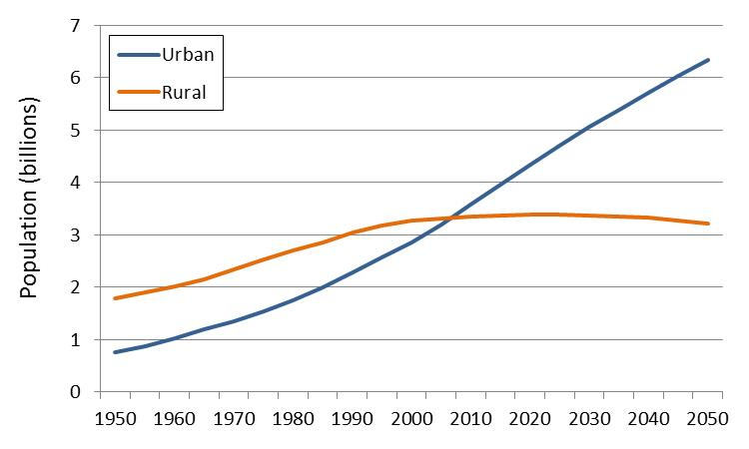

Indicators
Measure attributes/monitor trends in areas of concern – focussing on a specific region and point in time/period
Focus of this work – City Indicators
> 50% population live in cities -> 66% by 2050 *
Cities generate ~70% of green house gas emissions (UN Habitat)
* https://esa.un.org/unpd/wup/Publications/Files/WUP2014-Highlights.pdf

Slide 4
Indicators - measure, monitor, manage Urban Development
Economic
Gross Domestic Product
Wealth Distribution/Poverty
Employment rate
Environmental
Water Quality:
Turbidity , Salinity, Temperature, Dissolved Oxygen, pH, Secchi depth, Nitrogen, Phosphorus and Chlorophyll
Air Quality
Social
Quality of Urban Life/Livability of a City
purchasing power, safety, health, commute time, pollution
index. = 65 + purchasingPowerInclRentIndex - (priceToIncomeRatio * 2) - cpiIndex / 5 + safetyIndex * 3 / 4 + healthIndex / 2 - trafficTimeIndex / 2 - pollutionIndex;

Slide 5

Sustainable City Indicators
Global City Institute
ISO 37120 Sustainable Development of Communities – Standardized Indicators for City Services and Quality of Life
enable any sized city to measure its social, economic, and environmental performance in relation to other cities
20 themes
City Services Education Energy Finance Recreation Fire & Emergency Response Governance Health Safety Solid Waste Transportation Urban Planning Wastewater Water | Quality of Life Civic Engagement Culture Economy Environment Shelter Social Equity Technology And Innovation Health Number of in-patient hospital beds per 100,000 population Number of physicians per 100,000 population Average life expectancy Under age five mortality per 1,000

Slide 6
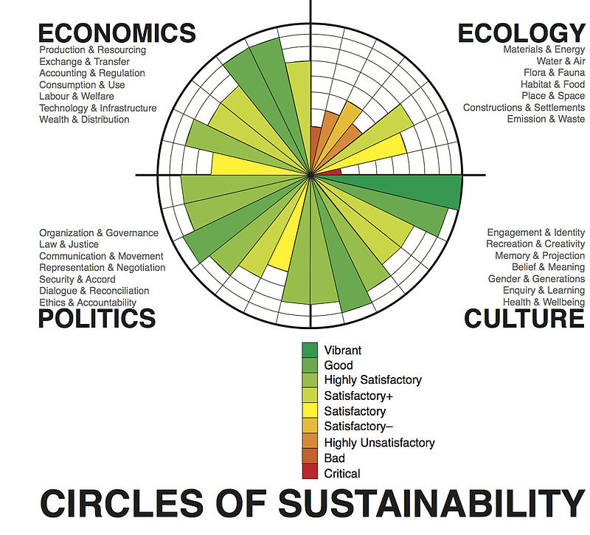
Melbourne 2011

Slide 7

World Bank Indicators
Agriculture & Rural Development
Aid Effectiveness
Climate Change
Economy & Growth
Education
Energy & Mining
Environment
External Debt
Financial Sector
Gender
Health
Infrastructure
Poverty
Private Sector
Public Sector
Science & Technology
Social Development
Social Protection & Labor
Trade
Urban Development

Slide 8
Green City Index
Amsterdam
CO2
CO2 emissions
CO2 intensity
CO2 reduction strategy
Energy
Buildings
Transport
Water
Waste & land use
Air quality
Environmental governance
Sofia

Slide 9
How to compare, re-use, map between Indicators?
GCI Indicators - >146 indicators
Circles of Sustainability Indicators
UN Habitat Global Urban Indicators
EuroStat Urban Audit >250 indicators
Green City Index – weighted combination of 30 indicators

Slide 10

Interoperability Issues
Same names – different formula
Different names – same formula
At indicator level
At input variable level
Different data/variable sources
Missing data/ missing source/provenance
Different units (people per km2, people per sq mile)
Different geographic regions
Geographic boundaries change over time
Different weightings (compound indicators)

Slide 11
Ontological Representation?
Ontology – in OWL/RDFS - capture definitions of different indicators
Document categories of indicators and relationships between indicators/sub-indicators/indices
Provides resource for choosing indicators for new projects – design monitoring programs
Documents the provenance
Enables dynamic calculation of indicators from data sources e.g. SDMX interface to ABS
JSON APIs to gov data, wireless sensors, industry data, crowd sourced data -> near real-time
Statistical analysis -> similarities, rule & relationship extraction?
Extract/document causal or other relationships/links between indices/indicators
overcrowding -> poor educational outcomes;
long commute time -> poorer health

Slide 12
Related Ontologies/Projects
Foundation Ontology for Global City Indicators (Mark Fox)
Open City Data Pipeline
City Data Ontology
http://citydata.wu.ac.at/ontology.html#
QuerioCity
CitySDK

Slide 13
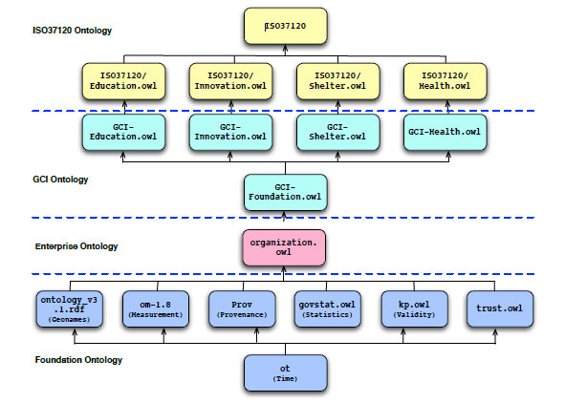

Slide 14
Urban Analytics Data Infrastructure (UADI)
ARC LIEF LE160100174 A digital data infrastructure: to enable the integration, harmonisation, connectivity and scalability of multi-source urban datasets. that will develop a New ontological framework and an urban data dictionary to underpin the next generation of data driven modelling and decision-support tools to enable smart, productive and resilient cities.

Slide 15
UADI Inputs: Scenario
What are Policy implications of Housing Intensification across Metropolitan areas in Australia
Demographic
Relation of housing type and household size
Ratio of active age cohort to employment ratio
Housing
Housing size, type, and diversity
Housing/Rental affordability
Economic
Locational variation of property price
Number of jobs/full-time employment
Environmental
Energy consumption and carbon emission in central cities
Urban Heat Island (UHI) Measures
Transportation
Accessibility
Infrastructure
Residential electrical energy use per unit of dwelling per year
Water consumption per capita/household/dwelling units (litres/day)

Slide 16
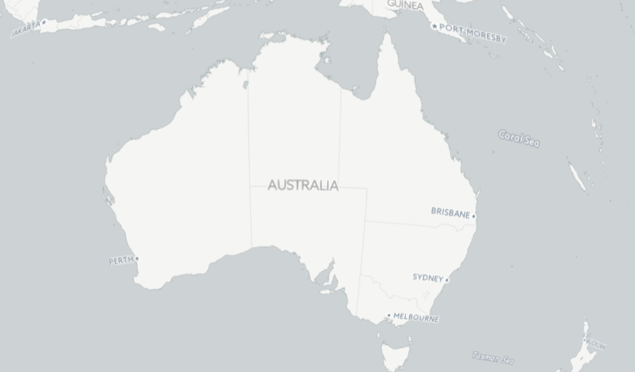
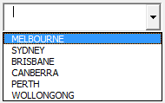









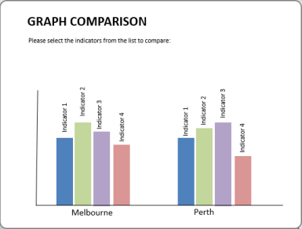
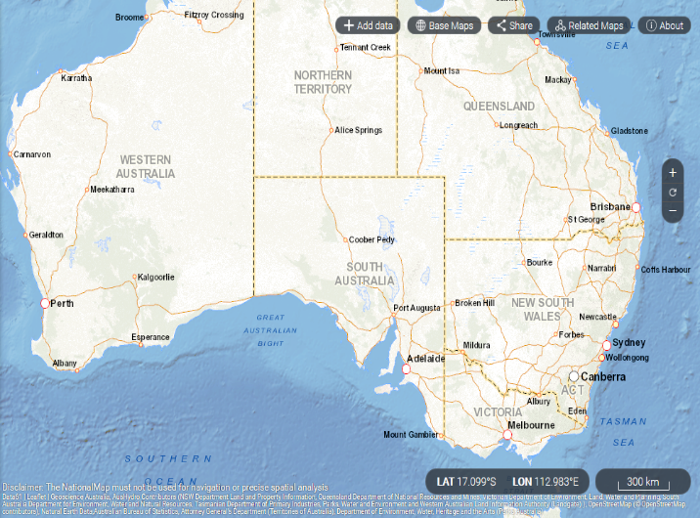
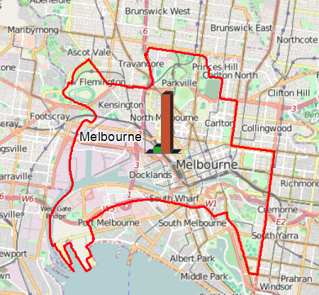

Portal of Urban Analytics Data Infrastructure
Home
About project
Search datasets
City indicators
Analytics
Partners
ISO 37120 INDICATORS
Housing Intensification
City
MELBOURNE
MORE INDICATORS
Environmental Implications
TRANSPORT
ECONOMY
ENVIRONMENT
URBAN PLANNING
COMPARE CITIES
SHELTER
ENERGY
WATER AND SANITATION
Search datasets:
MELBOURNE
Map View
Graph View
Table View

Slide 17
Problems
Majority of ISO37120 indicators not applicable 15.1 % of population living in slums
Whole city-level only
Need more fine-grained researcher-defined project specific indicators for the UADI project
Users are researchers, planners, policy makers – not UN, World Bank
Need to support local perspective not global

Slide 18
UADI Challenges – Shelter Indicators
Many of the required urban indicators not in ISO 37120
Many indicators defined by researchers
Underlying data is not available, or need it at finer geographic level
15 Shelter:
15.1 - % of population living in slums – not relevant in Australia.
15.2 – yes, relevant
15.3 is not really relevant.
We are interested in:
% of overcrowded households;
% of households that own their own home;
% of households that rent;
% of households in government/assisted housing;
Median mortgage
Affordability indicator

Slide 19
Transport Indicators
Regarding 18 Transportation:
18.1 – no
18.2 – no
18.3 – yes we can calculate this
18.4 – no
18.5 – yes we can calculate this
18.6-18.9 – no
Transport Indicators
Median Journey to Work Time
Median Journey to Work Distance
Median Carbon Emissions

Slide 20
Label
Measure
hasLabel
hasSpatialContext
Description
subClassOf
hasDescription
Region
Indicator
Context
hasContext
hasCategory
hasTemporalContext
Date/Time
hasMethod
hasValue
category
hasUnits
Method
“Count”
“Measure”
“Observe”
“Calculate”
hasFormula
value
units
Formula
hasPrefixNotation
hasC
“+(-(A,B)*(C,D))”
hasB
Variable
hasA
Variable
INDICATOR CLASS
(informed by City Data Ontology
http://citydata.wu.ac.at/ontology.html
Variable

Slide 21
PopDensity
hasLabel
Density of Population in a region
hasDescriptor
Brisbane
SA3
PopDensity1
Context
hasContext
hasValue
hasMethod
09/08/2016
hasUnits
“Calculate”
value
hasFormula
hasPopulation
hasArea
Formula
“people per km²”
hasPrefixNotation
hasB
“/(A,B)”
hasA
Area
hasUnits
Population
hasValue
“square kilometers”
hasSource
hasValue
hasSource
value
URI
value
URI

Slide 22
PopDensity
hasLabel
Density of Population in a region
hasDescriptor
Brisbane
SA3
SpatialContext
PopDensity1
Context
hasContext
hasValue
hasMethod
09/08/2016
TemporalContext
hasUnits
“Calculate”
value
hasFormula
hasPopulation
hasArea
Formula
“people per km²”
hasPrefixNotation
Area
hasA
hasB
“/(A,B)”
hasUnits1
hasUnits2
hasUnits1
Population
Area
square km
square miles
hasValue
“square kilometers”
hasSource
hasValue
hasSource
value
Conversion
Factor
hasValue
0.386
URI
value
URI

Slide 23
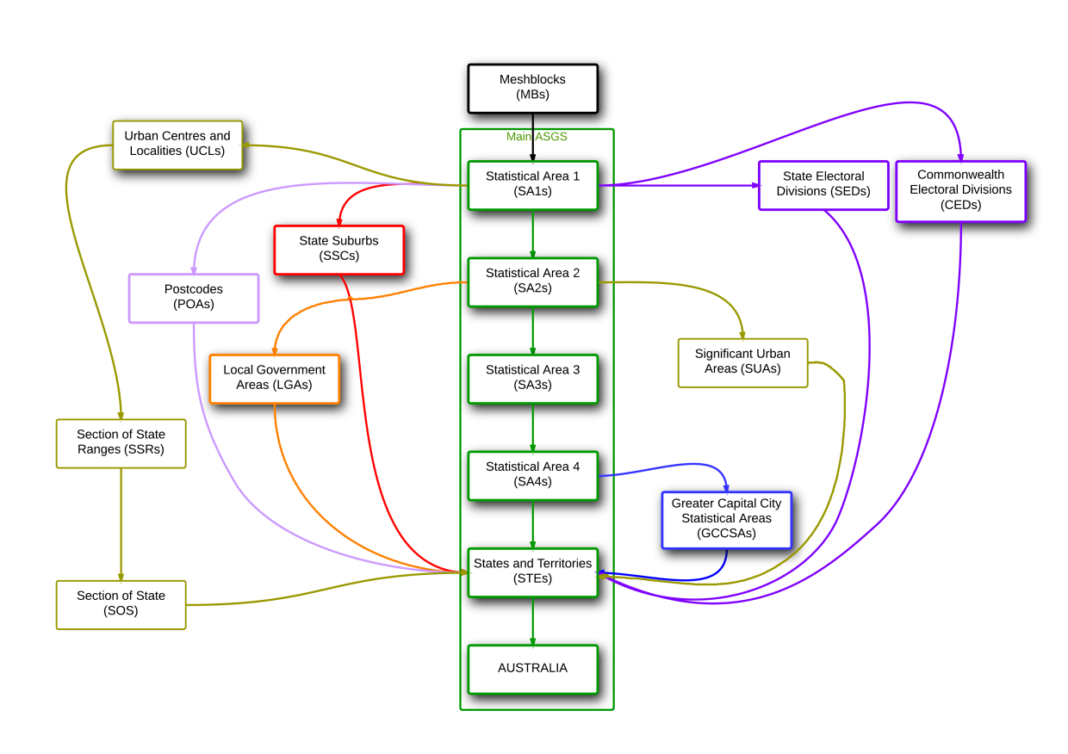
Australian Statistical Geography Standard ASGS
GeographicRegion
Name (geonames)
ID
GeographicLevel
Centroid
Boundary (shape file)
Area
Contains
ContainedWithin

Slide 24
Proposed Approach – Dynamic Interoperability between Indicators
Develop user interface (not ontology editor) that allows users to
Search, browse existing indicators in UADI ontology
Find similar indicators
Modify existing indicators & define their own
Indicator definition
Label, Description
Category (Transport, Economy, Environment, Housing, Health)
Method (Count, Calculate, Statistic, Observe, Measure, Complex)
Input Variables
URIs link to raw data via APIs (SDMX to Census data)
Mathematical formula
Relationships to other indicators (owl:equivalentProperty)
User interactively specifies:
Spatial context - region/city, geographic level (SA2, SA3, LGA)
Temporal context (2001, 2006, 2011)
Preferred Indicator values are dynamically generated and displayed on choropleths/graphs/tables

Slide 25






User Access
via Browser
Web Portal
HTML/JS/
CSS/JSON
Indicator Search,
Browse, Retrieve, Edit
SPARQL Endpoint
Visualization Services
OpenLayers Mapping
Processing.js
Google Charts
RDF Triple
Store
Indicator Ontology
Semantic integration
Middleware
Statistical Analyses
Java/R
REST API
REST/JSON API
REST
REST
Data Provider Service
DataSet/Metadata
Registry
Geoclassification
NodeJS
VTS/GeoInfo
NodeJS
SDMX Client
CKAN/DKAN
PostGreSQL+
PostGIS
ABS.Stat
SDMX Server
REST/JSON API
External
Datasets

Slide 26
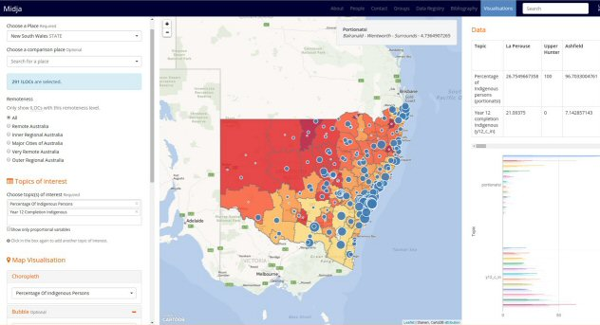





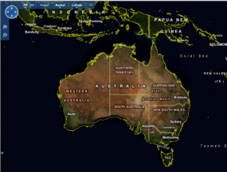
Use Access via Web Browser
Midja Portal
Web/Client Application
Authentication and access control
Search/Filter
Retrieve & Display
Web Server + Node.js
Visualization Tools
Maps/Graphs/Tables
Statistical
Analysis Tools
Google
Charts
CartoDB/ Open Layers
SDMX
PostGreSQL + PostGIS
ABS
Census Data
Indigenous
Business
Australia Data
Shape
Files
AEDC Indigenous
Early Childhood
Data
ABS.Stat
SDMX Server
ILOC, IARE, IREG
Geographies
Open Street Map

Slide 27
Example 1 – Journey to Work Data
ABS Journey to Work Data (Multi-Dimensional)
Retrieve using slices via ABS SDMX API
Source SA3 –> Destination SA3
Number of trips:
By Mode (Car, Bike, Public Transport, Walk)
By Gender
State Govt Transport Depts – Vehicle Registration data
Vehicle model ownership in each SA3
Vehicle model –> approx. CO2 emissions
Derived Urban Mobility Indicators (for each SA3)
Median Commute Distance
Median Commute Time
Proportion of People who use Public Transport
Median CO2 emissions

Slide 28
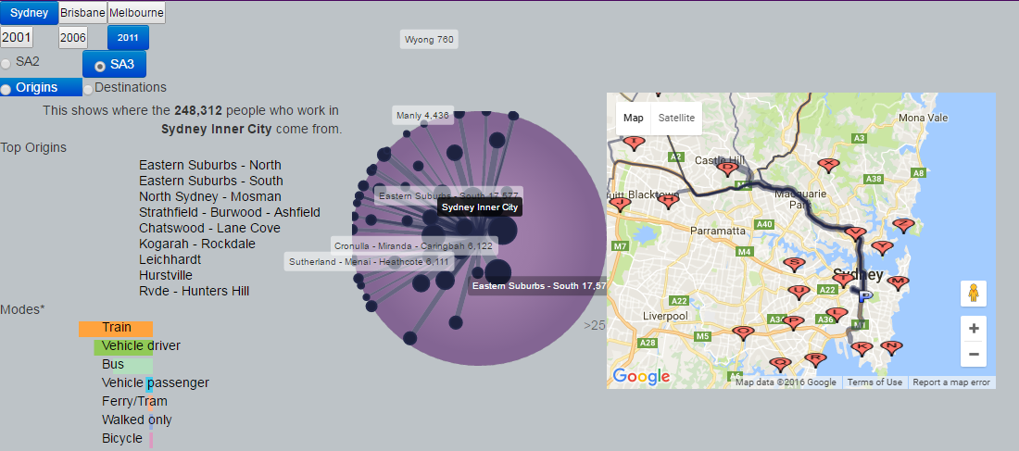
Journey to Work Visualization

Slide 29
Identify where PT Investments needed

Slide 30
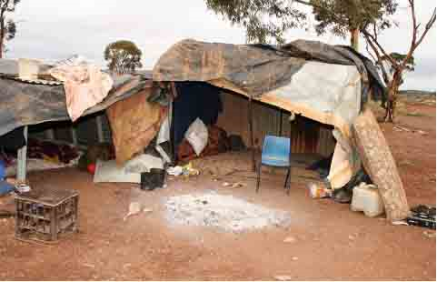
Example 2: Aboriginal Housing
Aboriginal communities:
Inferior housing
Inferior neighbourhoods
Low home ownership
Overcrowding, greater homelessness
More live in public housing
Frequently move house
-> Adverse impact on health, well-being and education of children
Budget 2015: $2bn for Indigenous housing and investment in remote areas

Slide 31
Researcher-defined Hypotheses
High overcrowding -> poor educational and health outcomes -> crime, domestic violence
Areas with the greatest housing demand are not necessarily the most remote
Current housing services (loans, commonwealth rental schemes, housing programs) – aren’t focussed on areas with greatest demand
Palm Island – vacant new houses
Doomadgee, Nhulunbuy – adequate housing – discrete communities
Winton, Dubbo – high homelessness, high overcrowding – rural towns

Slide 32
Midja Web Portal System
Web Interface enables users to:
1. Select regions of interest (e.g. States) and geographic level (LGAs)
Australia, Queensland, Tasmania
2. Filter out LGAs that don’t meet criteria (no. of Indig. Households<20; Remoteness)
3. Select indicators/variables of interest – e.g., Overcrowding, Year 12, PIHO index, No. of IBA Loans
4. Overlay selected indicators on a map – using choropleths and bubbles
Pan and zoom using map interface
Left click on an LGA -> Displays all data/indicators for that LGA
5. Graphically present indicators/variables on scatter plots
6. Apply simple statistical analyses to the data sets (e.g. Linear Regression)

Slide 33
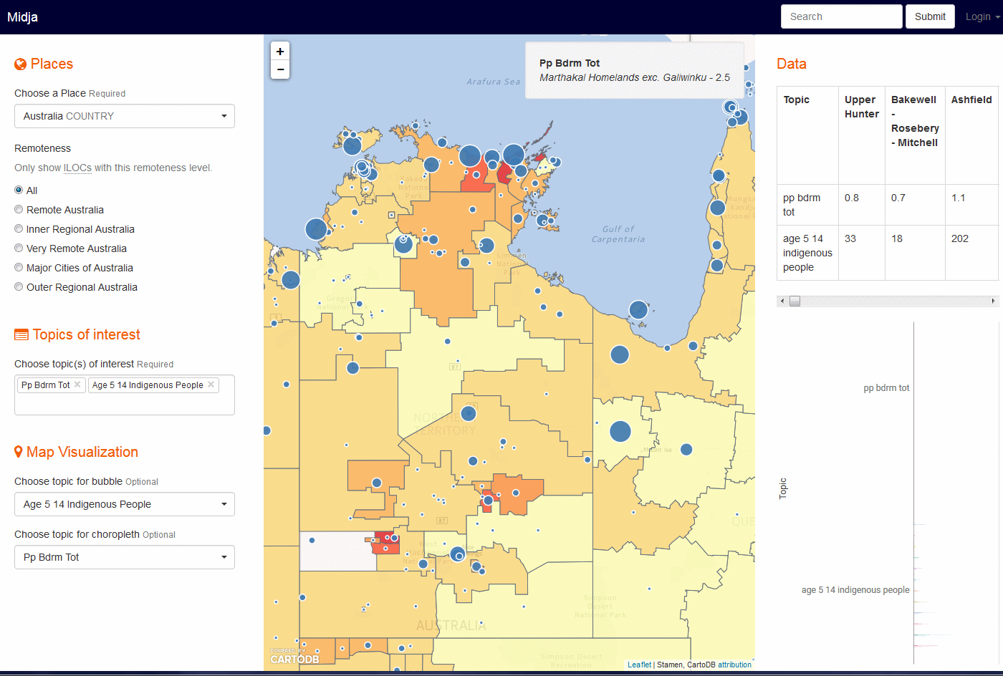

Slide 34
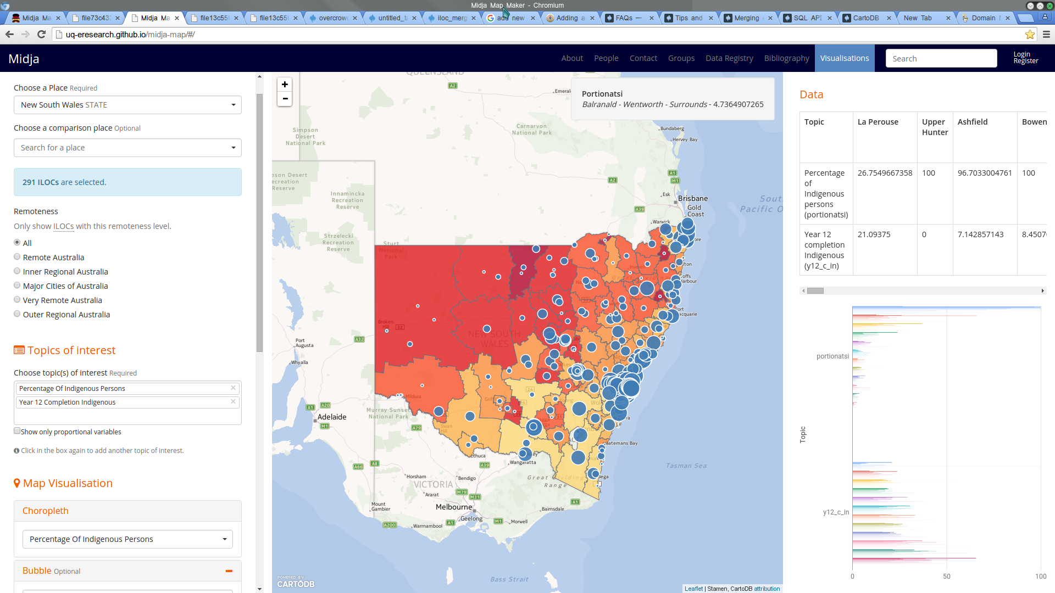

Slide 35
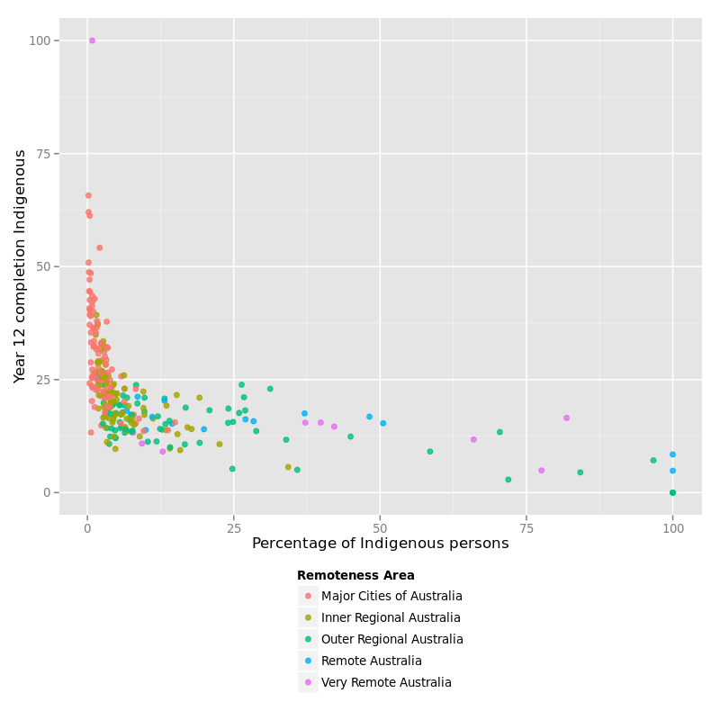

Slide 36
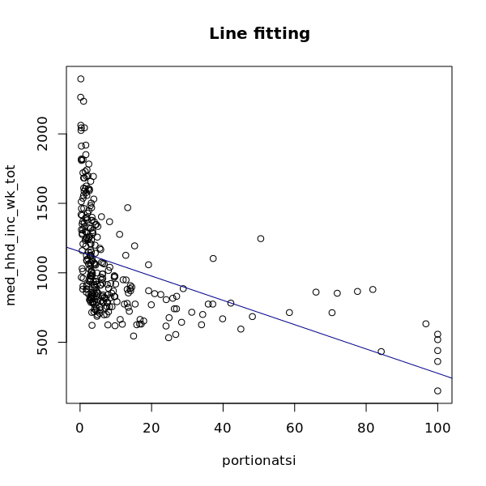

Slide 37
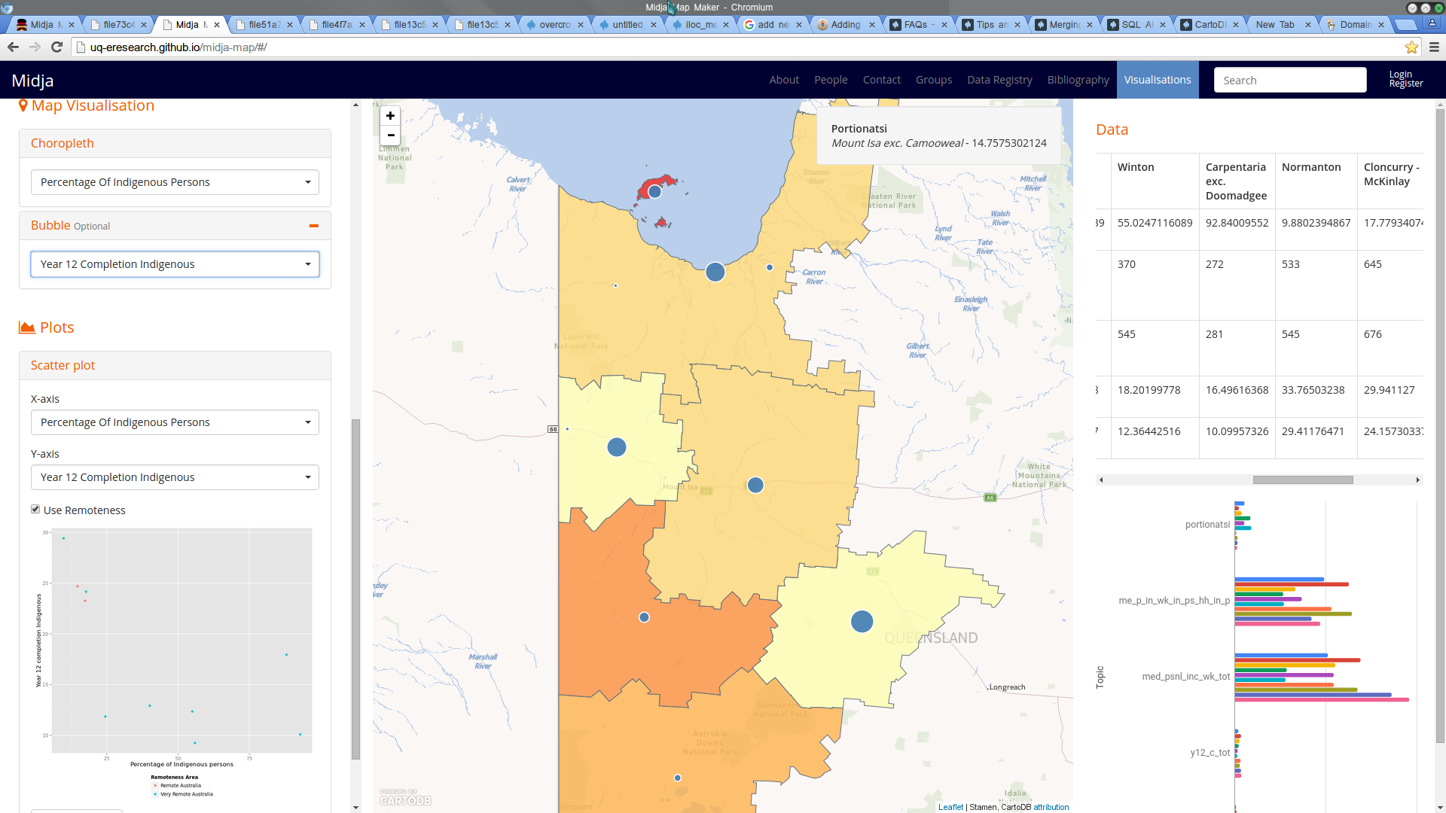

Slide 38
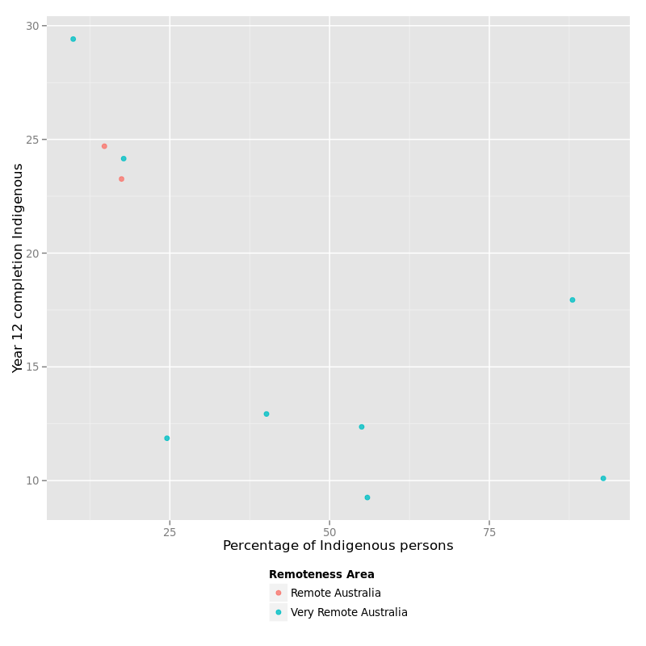
Regional Cities
Worst housing, educational and health
outcomes for Indigenous people
Living in Rural Towns
approx. 50% Indigenous
few services
Discrete
Communities
Rural Towns

Slide 39

Indigenous Business Australia
Jan 21, 2016

Slide 40
Calculate Potential Indigenous Home Ownership
For each LGA in Australia, calculate the Potential Indigenous Home Ownership (PIHO) Index
PIHO Index is a composite of three variables for each LGA:
Affordability Index (= Median Indig. Income/Median Mortgage)
% of Indigenous Households who don’t own their own home
% of Indigenous Population in Full-time Employment
(Note – the PIHO calculation can easily be modified/refined)

Slide 41
Overlay IBA data and PIHO Data Spatially
Using aggregated IBA Data from 1981 – 2014
Each Customer is geocoded by matching their postcode to an LGA
Calculate Total Number of IBA Loans and Total Amount of IBA Loans – for each LGA - by aggregating data for postcodes in that LGA
Link data to Midja system

Slide 42
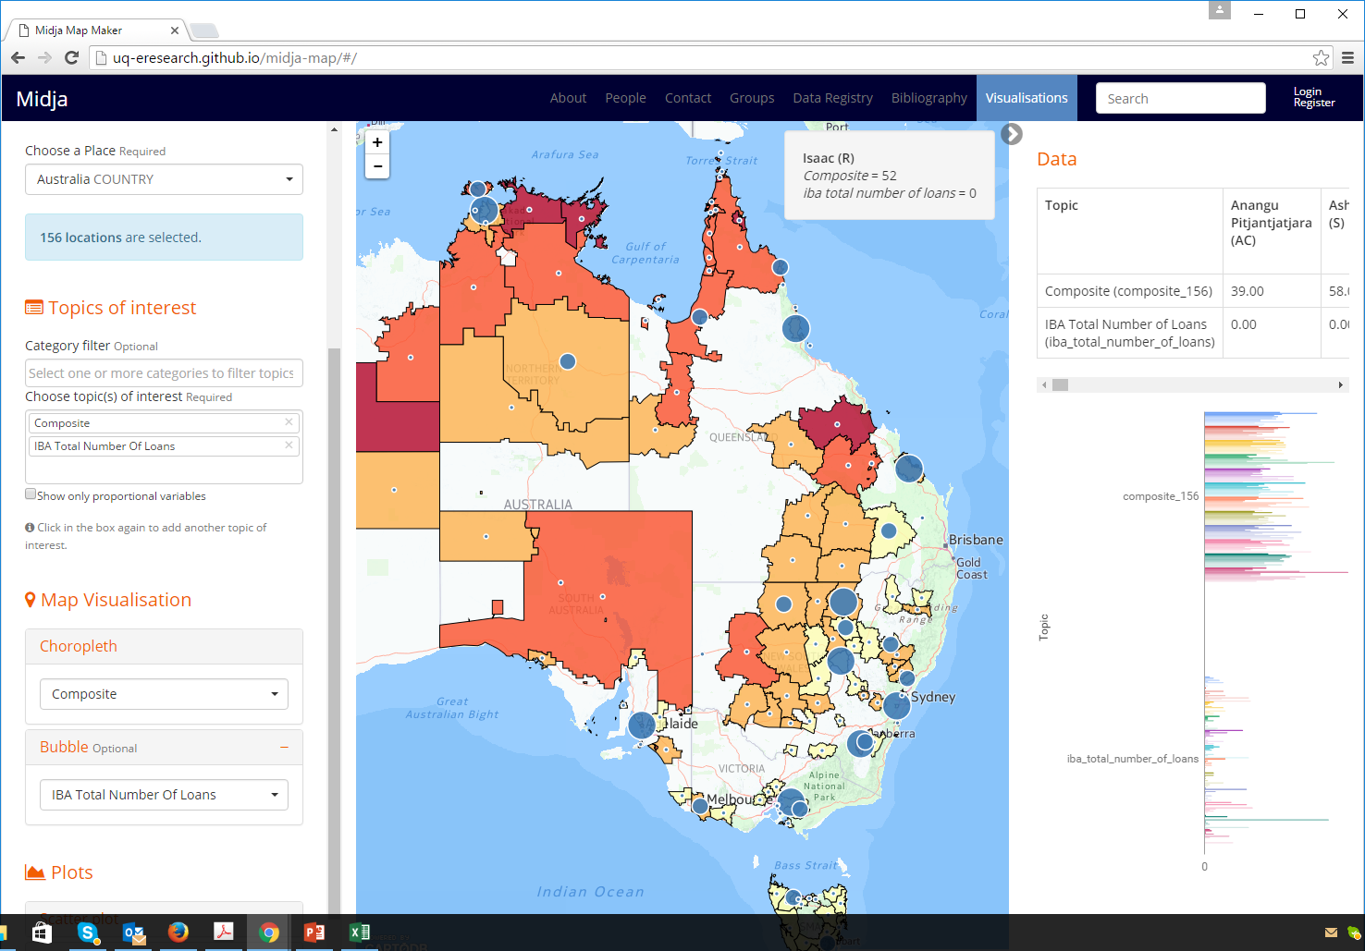

Slide 43
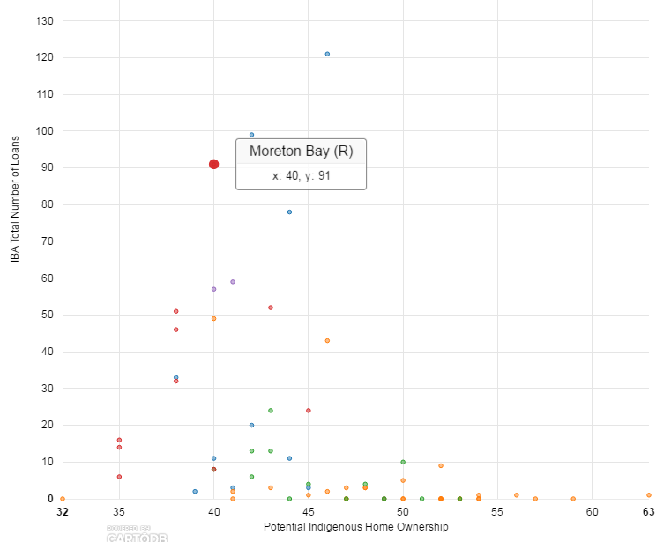
Scatter Plots
Interactively generated by user
PIHO Index - X-axis
No of IBA Loans - Y-axis
Reveals LGAs with high potential but no loans
Mouse over point
displays LGA name + X, Y values

Slide 44

Significance to IBA?
Reveals LGAs with high Potential Indigenous Home Ownership but few IBA loans
Qld – Isaac, Lockhardt River, Aurukun, Barcoo, Cherbourg, McKinlay
NSW – Central Darling, Balranald,
Victoria - Horsham
Tasmania – Launceston, Flinders, King Island
South Australia – Kimba, Wudinna, Elliston
Western Australia – Ashburton, Perenjori
Northern Territory – West Arnhem, East Arnhem
Identifies areas for targeting Future Marketing

Slide 45
Example 3 – EBPM & Adaptive Management Cycle
Management
Action/Decision
Database
If Management Actions
are having no impact on target
Indicators, adapt Actions
Web
Portal
EBPM Ontology
Predictive
Scenario-based
Models
Integrated
Monitoring Data
-> Indicators

Slide 46
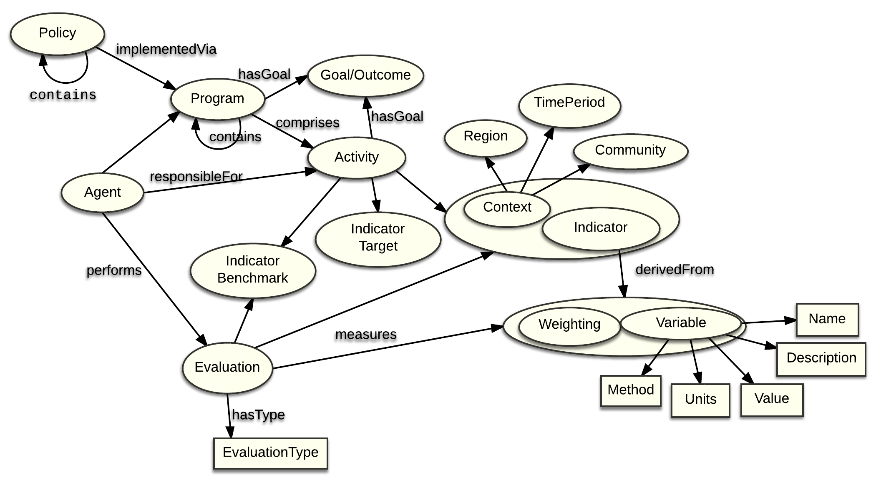
Evidence-Based Policy Making Ontology

Slide 47
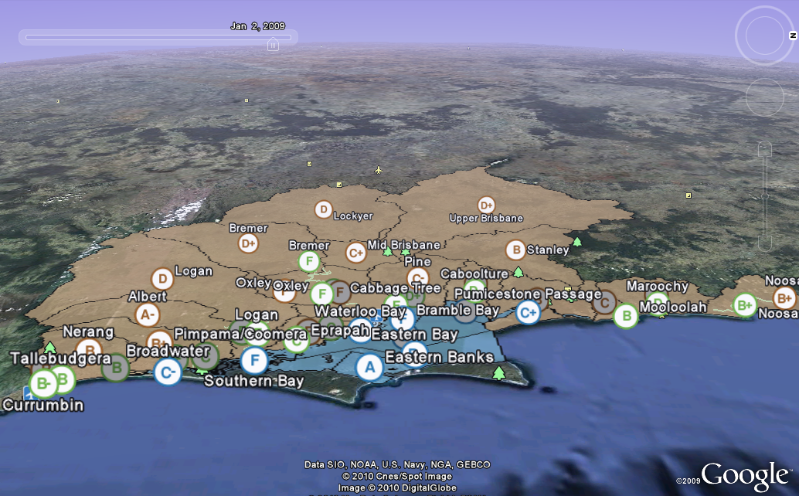
Online Ecosystem Health Report Cards

Slide 48
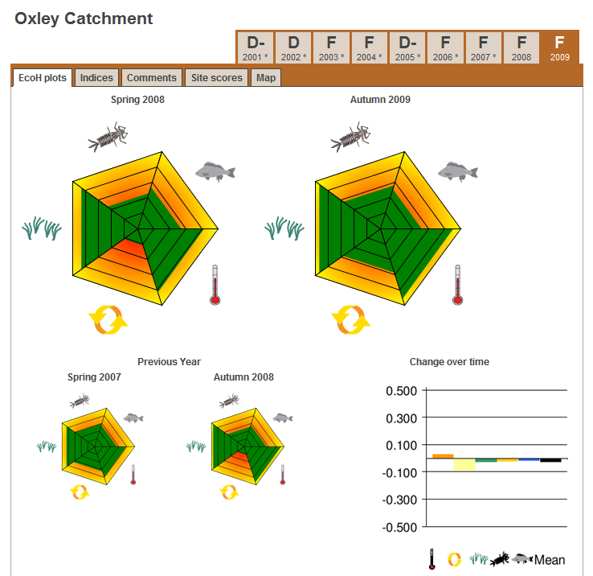
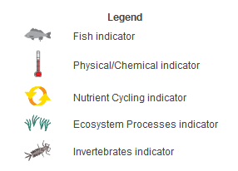
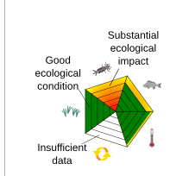

Slide 49
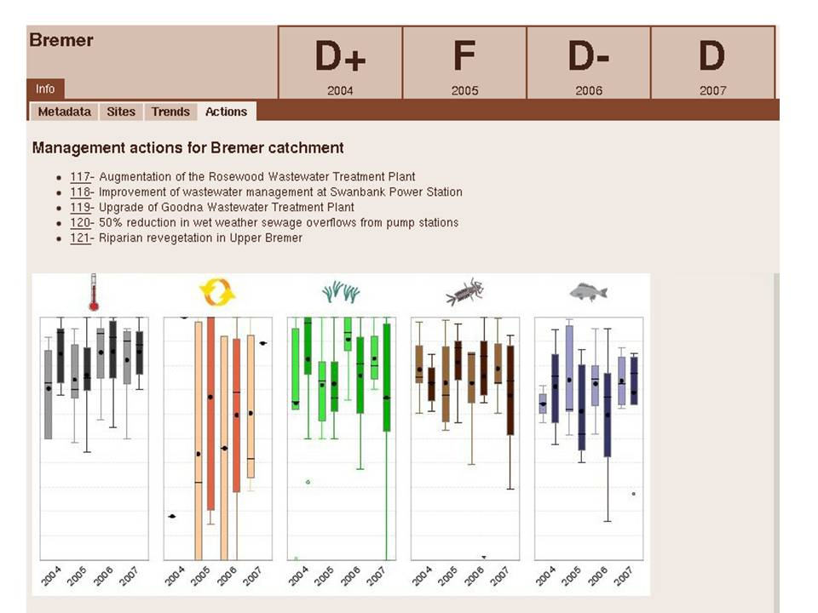
Management Actions Linked to Environmental Outcomes/Targets
“Reduce the nutrient level at sites 123-130 in the Bremer River by 25%”

Slide 50
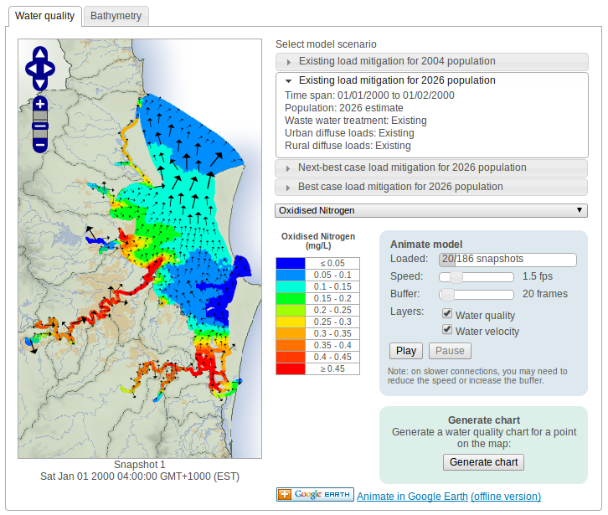

Slide 51
Research Areas with Significant Need/Potential
Automate discovery of data/variables to underpin indicators
Extend Indicator Ontology to:
link indicators and monitoring data to targets, action plans and policies (EBPM)
Use regression analysis & PCA to enhance data quality, detect/document relationships/correlations between indicators
overcrowding -> poor educational outcomes;
long commute time -> adverse health impact

Slide 52
Research Areas with Significant Potential
Model indicators/data over time & space
Develop and integrate predictive models
Estimate/document certainty/uncertainty associated with inferred RDF triples/facts
Hypothesis Testing for researchers
Apply & Evaluate in the context of Smart Sustainable Cities

Slide 53

Acknowledgments
ARC Indigenous Discovery IN140100033
Carroll Go-Sam, Paul Memmott, School of Architecture
Mark Moran, Institute for Social Science Research
ARC LIEF LE160100174 Urban Analytics Data Infrastructure
http://www.csdila.unimelb.edu.au/projects/UADI/
Guohun Zhu, ITEE, UQ
Andre Gebers, ITEE, UQ
Flavio Pileggi, ITEE, UQ

Slide 54

Contact
Jane Hunter <j.hunter@uq.edu.au>
eResearch Lab at the University of Queensland
http://www.itee.uq.edu.au/~eresearch

Slide 55
CfP Special Issue of JWS Semantic Statistics
• Submission deadline: 15 Dec, 2016
• Author notification: 1 March 2017
• Final version: 1 May, 2017
• Publication: 3rd quarter, 2017

